Slide 1

Imputing Missing Gene Expression Values Using 3D Gene Conformation Data and Kriging Interpolation
LIANG Tianyi
Notes:
"Good morning/afternoon everyone. My name is Liang Tianyi, and today I will be presenting my work on imputing missing gene expression values using 3D gene conformation data and Kriging interpolation. This presentation will cover the motivation, methodology, results, and future work related to this project. Let's get started."

Slide 2

Outline
Introduction
Methodology Overview
Understanding Real Data
Strong Assumptions and Synthetic Data Generation
Masking Experiment
Kriging Interpolation Method
Evaluation Metrics Overview
Results Analysis
Final Imputation Results
Conclusion
Future Work
Notes:
"Good morning/afternoon everyone. My name is Liang Tianyi, and today I will be presenting my work on imputing missing gene expression values using 3D gene conformation data and Kriging interpolation. This presentation will cover the motivation, methodology, results, and future work related to this project. Let's get started."

Slide 3
1. Introduction
Background and Importance of 3D Gene Conformation:
Genes are organized in a three-dimensional (3D) conformation within the nucleus, and genes that are spatially closer to each other tend to be co-regulated. This spatial organization plays a crucial role in gene regulation and expression.
Objectives of the Study:
The primary objective of this project is to leverage known population-level 3D gene conformations to impute missing gene expression values in single cells. By utilizing spatial information, we aim to improve the accuracy of imputed values and enhance the reliability of subsequent analyses.
Notes:
"Let's begin with the background and importance of 3D gene conformation. Genes are organized in a three-dimensional structure within the nucleus. This organization is crucial because genes that are spatially closer tend to be co-regulated. This spatial relationship plays a significant role in gene regulation and expression.
The primary objective of this study is to leverage this spatial information to impute missing gene expression values in single cells. We aim to improve the accuracy of these imputations and enhance the reliability of subsequent analyses."

Slide 4
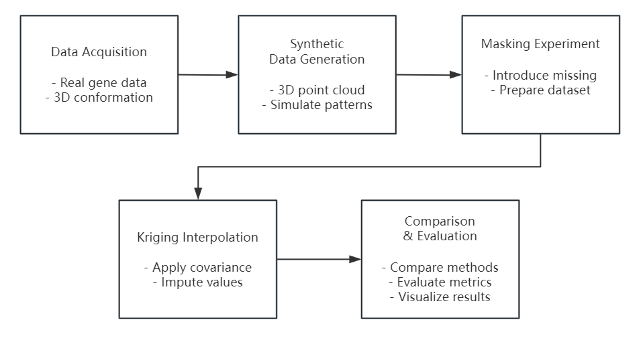
2. Methodology Overview
Flowchart of Experimental Workflow:
Notes:
"Now, let's look at the methodology overview for our study. This flowchart summarizes the experimental workflow.
Data Acquisition: We begin by collecting real gene data and their 3D conformations.
Synthetic Data Generation: Next, we generate synthetic 3D point cloud data to simulate gene expression patterns within cells.
Masking Experiment: In this step, we introduce missing values to prepare the dataset for interpolation.
Kriging Interpolation: We apply kriging interpolation using the spatial covariance matrix to impute the missing values.
Comparison & Evaluation: Finally, we compare the imputed values with existing methods, evaluate various metrics, and visualize the results.
This approach ensures that we can systematically address the challenges of imputing missing gene expression values using 3D gene conformation data."

Slide 5
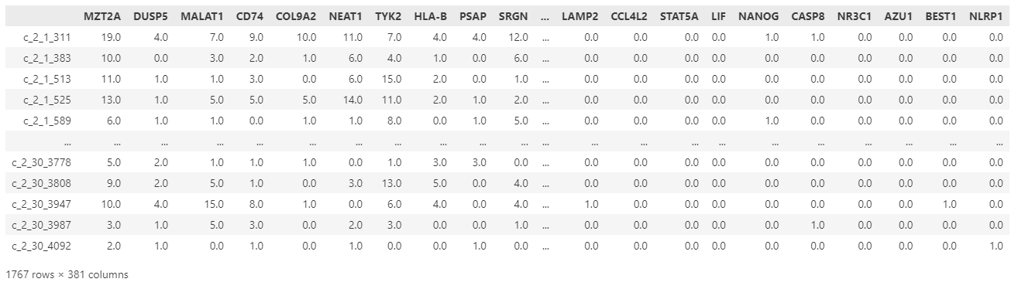
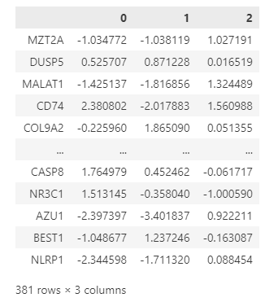
3. Understanding Real Data
Real gene expression data
3D gene conformation data
Challenges in Real Data
1. High prevalence of zero values
2. Ambiguity between technical missing values
and biologically low expression
Notes:
"This slide shows the real data:
Real Gene Expression Data: The table shows gene expression levels with many zero values.
3D Gene Conformation Data: This table illustrates the spatial organization of genes.
Challenges are that:
Many zero values complicate analysis.
It’s hard to tell if zeros are due to missing data or low expression.
Understanding these challenges is key for our imputation method."

Slide 6
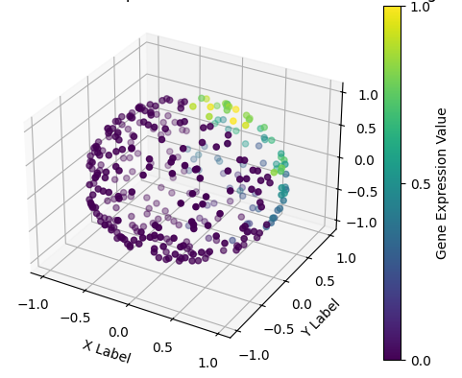
4. Strong Assumptions and Synthetic Data Generation
Strong Assumption Justification
Real data challenges: Missing and zero values indistinguishable.
Synthetic data simulation for controlled experiments.
Uniform 3D distribution within a spherical volume.
Strong Assumption Conditions
Ignoring real 3D gene distribution.
Using idealized or synthetic point cloud data for analysis and validation.
Simulating gene expression patterns with a controlled distribution.
Simulation of Gene Distribution
Notes:
"We use strong assumptions to handle real data challenges where missing and zero values are indistinguishable.
Synthetic data allows for controlled experiments, uniformly distributed within a spherical volume.
We ignore real 3D distributions and use synthetic data for validation, simulating gene expression patterns under controlled conditions. The visual shows our synthetic gene distribution."

Slide 7
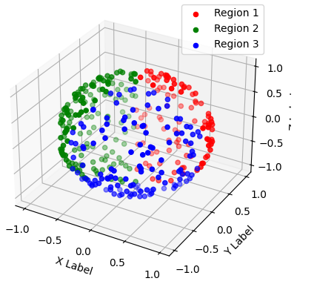
4. Strong Assumptions and Synthetic Data Generation
Strong Assumption Conditions
Generated 381 uniformly distributed points within a unit sphere.
Divided into three regions based on angles (0°-120°, 120°-240°, 240°-360°).
Gene expression values correlated with z-axis, with added random noise.
Three different cell types simulated by varying expression patterns in regions.
Notes:
"In our synthetic data generation, we used strong assumptions.
We generated 381 points uniformly distributed within a unit sphere.
These points are divided into three regions based on specific angles.
Gene expression values are correlated with the z-axis and include random noise.
By varying expression patterns in these regions, we simulated three different cell types.
The visual on the slide shows the resulting synthetic gene distribution."

Slide 8
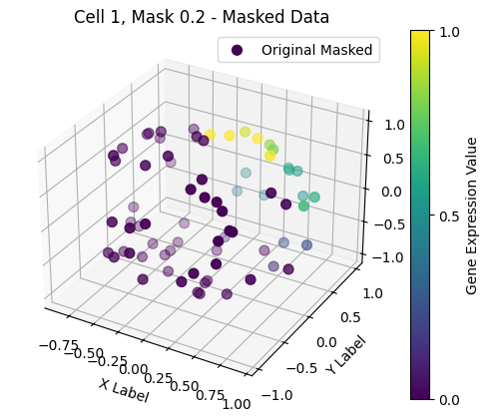
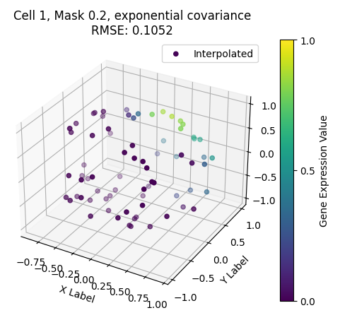
5. Masking Experiment
Introducing Missing Values
Randomly mask 10%/20%/30% of gene expression values in synthetic data.
Prepare datasets with missing values for interpolation testing.
Example of Masked Data
Notes:
"To test our interpolation method, we introduced missing values into the synthetic data by randomly masking 10%, 20%, and 30% of the gene expression values.
This creates datasets with missing values for our interpolation testing.
On the slide, you can see an example of masked data on the left and the corresponding imputed data using exponential covariance on the right."

Slide 9
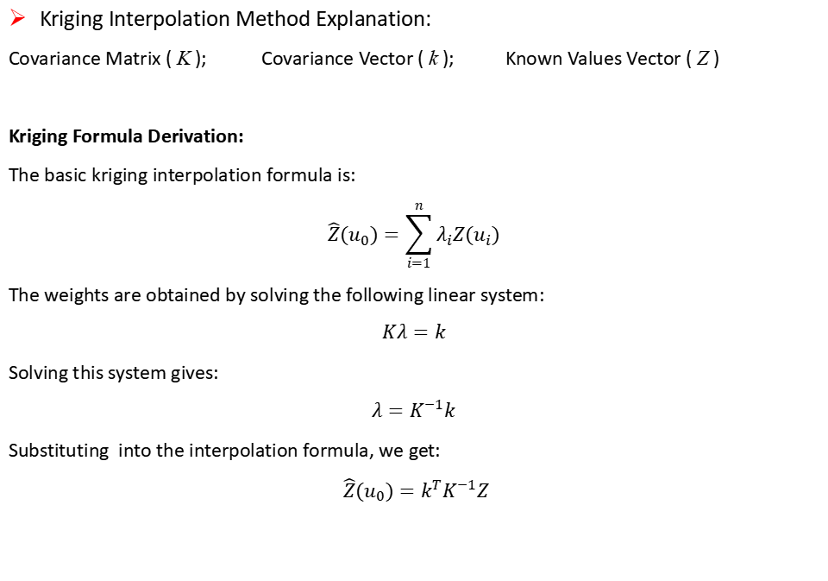
6. Kriging Interpolation Method
Kriging Interpolation Method Explanation:
Covariance Matrix ( K ); Covariance Vector ( k ); Known Values Vector ( Z )
Kriging Formula Derivation:
The basic kriging interpolation formula is:
$$\hat{Z}(u_{0})=\sum_{i=1}^{n}{λ_{i}Z(u_{i})}$$
The weights are obtained by solving the following linear system:
$$Kλ=k$$
Solving this system gives:
$$λ=K^{−1}k$$
Substituting into the interpolation formula, we get:
$\hat{Z}(u_{0})=k^{T}K^{−1}Z$
Notes:
"In this slide, I will explain the kriging interpolation method used in our study.
The kriging interpolation relies on three key components: the covariance matrix 𝐾, the covariance vector 𝑘, and the known values vector 𝑍.
The kriging formula is designed to predict the value at a new point based on the values at known points.
The basic kriging interpolation formula is shown here. The weights 𝜆𝑖are determined by solving a linear system of equations.
By solving for 𝜆, we can substitute it back into the interpolation formula to predict the missing values accurately.
This method leverages the spatial relationships captured in the covariance matrix to enhance imputation accuracy."

Slide 10
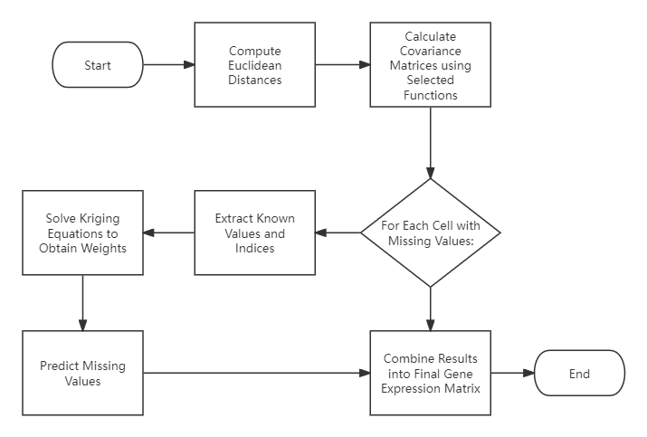
6. Kriging Interpolation Method
Kriging Interpolation Flowchart
Notes:
"This slide presents the kriging interpolation method using a flowchart. Here's the process:
Compute Euclidean Distances: Calculate the distances between gene points.
Calculate Covariance Matrices: Use selected functions to compute the matrices.
Extract Known Values and Indices: Identify the known gene expression values.
Solve Kriging Equations: Obtain the weights by solving the kriging equations.
Predict Missing Values: Use the weights to predict the missing gene expression values.
Combine Results: Integrate the predicted values into the final gene expression matrix.

Slide 11
7. Evaluation Metrics Overview
Root Mean Square Error (RMSE)
Measures interpolation accuracy.
Lower RMSE indicates better accuracy.
Local Variation
Assesses smoothness of interpolated data.
Includes standard deviation and local statistical metrics.
Spectral Analysis
Evaluates frequency components of data.
Identifies patterns and periodicities.
Roughness Measures
Quantifies lack of smoothness.
Includes total curvature and total variation.
Notes:
This slide outlines the evaluation metrics used in our study:
Root Mean Square Error (RMSE) measures the interpolation accuracy. A lower RMSE indicates better accuracy.
Local Variation assesses the smoothness of the interpolated data by considering standard deviation and local statistical metrics.
Spectral Analysis evaluates the frequency components of the data, identifying patterns and periodicities.
Roughness Measures quantify the lack of smoothness, including metrics like total curvature and total variation.

Slide 12
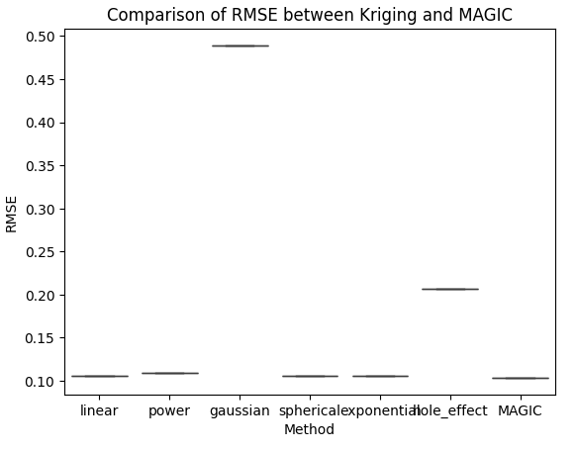
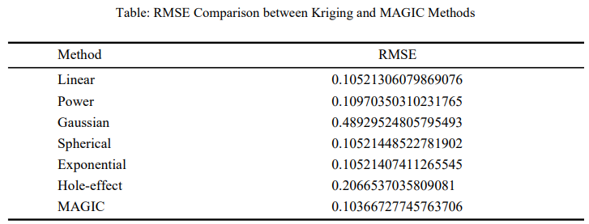
8. Results Analysis
Interpolation Results Comparison
RMSE Comparison between Kriging and MAGIC Methods
Notes:
"In this slide, we present the results of our interpolation methods:
We compared the RMSE of different Kriging interpolation methods with the MAGIC method.
The graph on the right shows the RMSE values for each method.
The table below provides the exact RMSE values.
From the results, we can see that the Exponential Kriging method performs comparably to the MAGIC method, with a slightly higher RMSE. The Gaussian method had the highest RMSE, indicating it was the least effective in our tests."

Slide 13
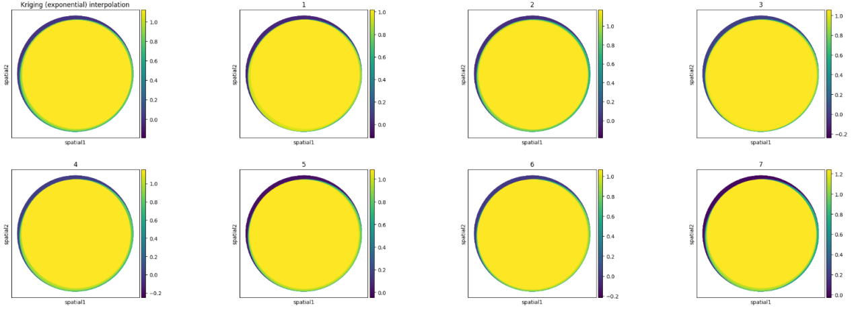
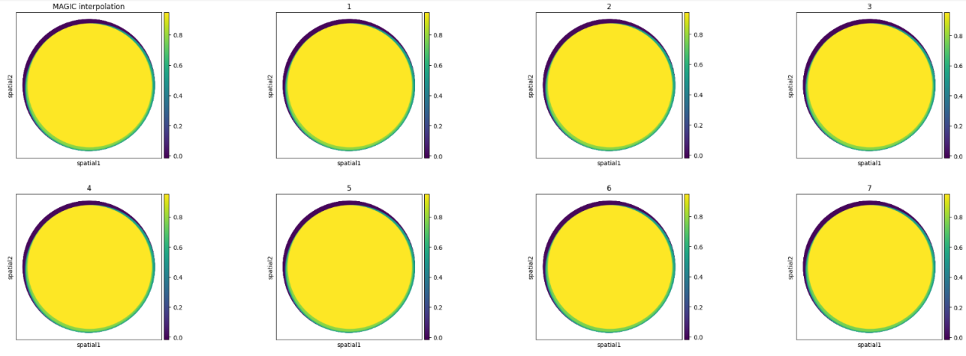
8. Results Analysis
Color Map Comparison
Notes:
"In this slide, we present the color map comparison of gene expression values:
The top row shows the interpolation results using the Kriging Exponential method.
The bottom row shows the results using the MAGIC method.
Each cell's gene expression values are visualized, with colors representing different expression levels.
By comparing these color maps, we can observe that the Kriging Exponential method and the MAGIC method produce visually similar patterns of gene expression, indicating the effectiveness of the Kriging method in imputing missing values."

Slide 14
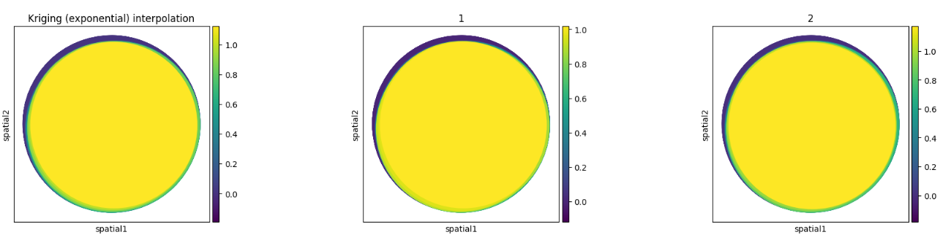
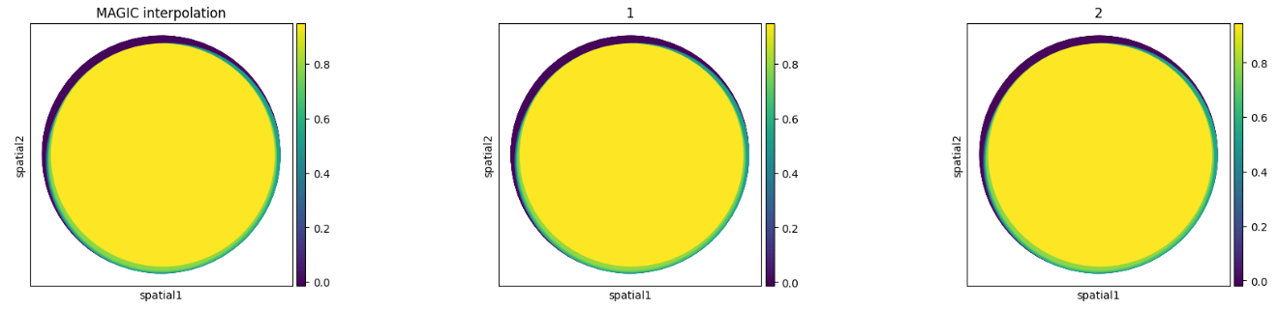
8. Results Analysis
Color Map Comparison
Notes:
"In these visualizations, we compare the gene expression patterns obtained using Kriging (Exponential) and MAGIC interpolation methods."
"Each map represents a different cell, with colors indicating the gene expression values. Yellow indicates higher expression levels, while purple indicates lower expression levels."
"As we can see, the Kriging interpolation tends to [highlight any specific patterns, e.g., better preserve spatial continuity or introduce specific artifacts]."
"On the other hand, MAGIC interpolation [describe its visual characteristics, e.g., smooths the data but might over-smooth certain regions]."
"These visual differences are crucial as they directly impact the downstream analyses such as clustering and identifying gene expression patterns."
"Overall, while both methods have their strengths, the choice between them would depend on the specific requirements of the analysis."

Slide 15
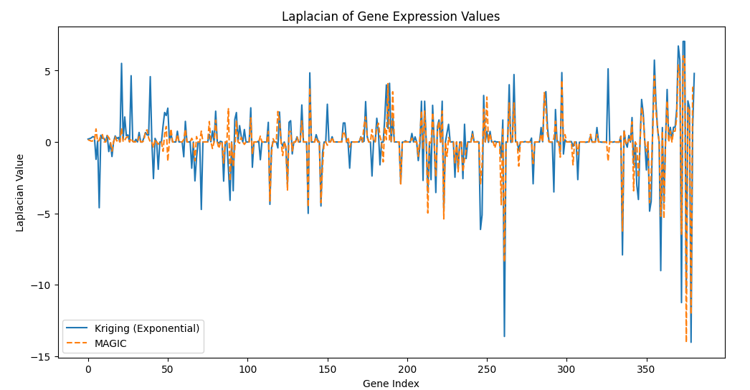
8. Results Analysis
Laplacian of Gene Expression Values
Kriging Interpolation (Exponential): Shows larger fluctuations, capturing more detailed information.
MAGIC Interpolation: Exhibits smaller fluctuations, resulting in more uniform smoothing but potentially losing details.
Notes:
"In this slide, we analyze the Laplacian of gene expression values:
The graph compares the Laplacian values for Kriging Interpolation using the Exponential method and the MAGIC method.
Kriging Interpolation (Exponential) displays larger fluctuations, indicating it captures more detailed information.
MAGIC Interpolation shows smaller fluctuations, leading to more uniform smoothing but possibly losing finer details.
This comparison highlights the different strengths of each interpolation method in handling gene expression data."

Slide 16
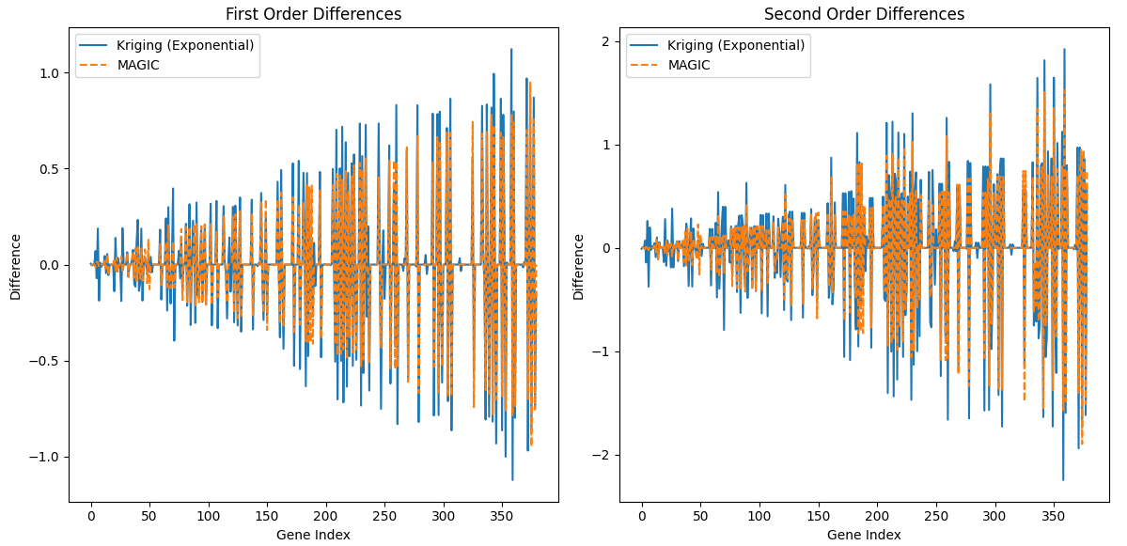
8. Results Analysis
Finite Difference Calculations
Finite Differences: Used to evaluate the rate of change and acceleration of the data.
Notes:
Kriging Interpolation (Exponential): Shows larger fluctuations in both first and second order differences, capturing more detailed variations.
MAGIC Interpolation: Exhibits smaller fluctuations, resulting in more uniform smoothing but potentially losing change information.
Finite Difference Calculations show the similar results
Kriging preserves data details better, while MAGIC provides a smoother but less detailed result.

Slide 17
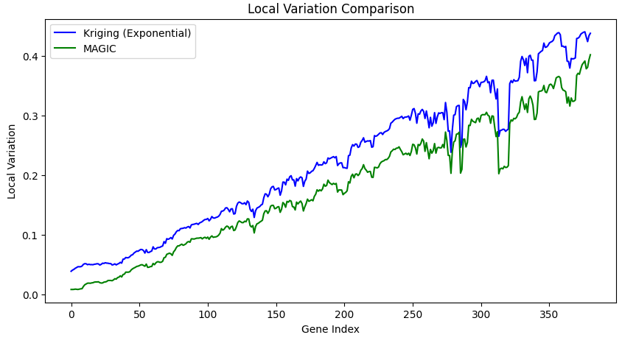
8. Results Analysis
Local Variation Measures
Local Variation: Used to assess the degree of variation within local regions of the data.
Notes:
Kriging Interpolation (Exponential): Shows higher local variation, indicating sensitivity to local changes.
MAGIC Interpolation: Exhibits smaller local variations, providing smoother results but potentially missing subtle local changes.
结论：
Kriging captures local variations better, while MAGIC offers smoother but less detailed results.

Slide 18
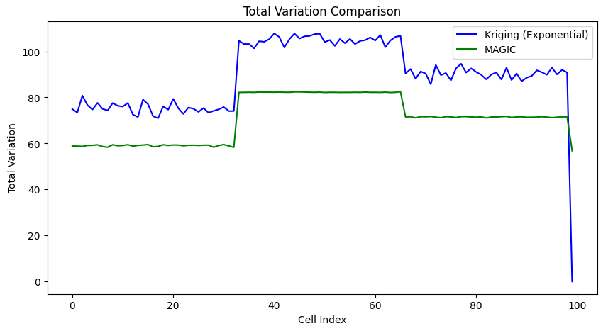
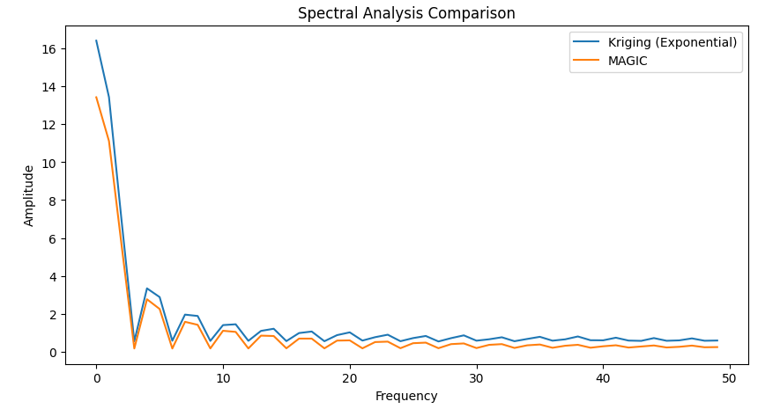
8. Results Analysis
Spectral Analysis and Roughness Metrics
These comparisons highlight that while both methods perform similarly in spectral analysis, Kriging tends to preserve more variability in the data, which might be advantageous for capturing intricate patterns in gene expression.
Notes:
Disadvantages of Kriging:
The increased total variation may also imply higher noise levels, which could affect the overall data quality.
Disadvantages of MAGIC:
May over-smooth the data, potentially obscuring subtle but important biological differences.

Slide 19
8. Results Analysis
Kriging preserves data details better, while MAGIC provides a smoother but less detailed result.
Notes:
All these graphs show the similar results
Kriging preserves data details better, while MAGIC provides a smoother but less detailed result.
Disadvantages of Kriging:
The increased total variation may also imply higher noise levels, which could affect the overall data quality.
Disadvantages of MAGIC:
May over-smooth the data, potentially obscuring subtle but important biological differences.

Slide 20
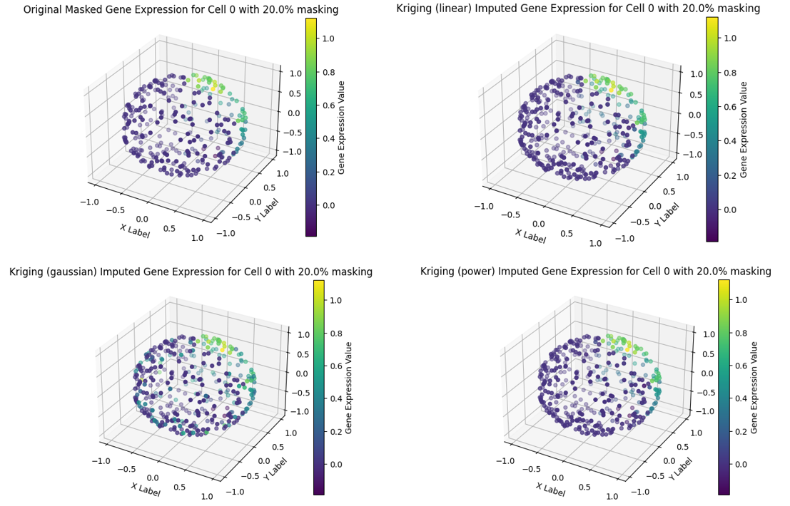
8. Final Imputation Results
Notes:
In this section, we present the imputation results using different interpolation methods and compare them with the MAGIC method.
Original Masked Data:
The original masked gene expression values are displayed for reference.
Kriging Interpolation:
Six different Kriging methods (Linear, Power, Gaussian, Spherical, Exponential, and Hole-effect) were applied.
Among them, the Exponential Kriging method showed the most promising results.
MAGIC Imputation:
MAGIC results are shown for comparison with the Kriging methods.

Slide 21
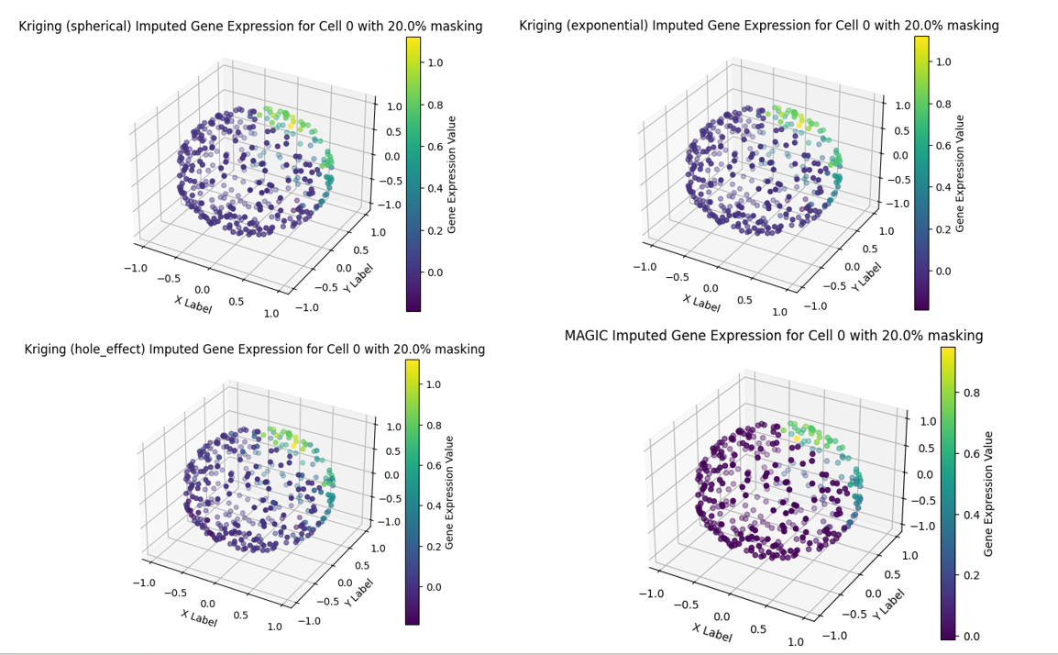
8. Final Imputation Results
Notes:
In this section, we present the imputation results using different interpolation methods and compare them with the MAGIC method.
Original Masked Data:
The original masked gene expression values are displayed for reference.
Kriging Interpolation:
Six different Kriging methods (Linear, Power, Gaussian, Spherical, Exponential, and Hole-effect) were applied.
Among them, the Exponential Kriging method showed the most promising results.
MAGIC Imputation:
MAGIC results are shown for comparison with the Kriging methods.

Slide 22
9. Conclusion
Summary of the Study:
Development and evaluation of a Kriging-based interpolation method for single-cell data.
Leveraging 3D spatial conformation of genes for improved accuracy.
Key Findings:
Exponential Kriging method showed promising results, comparable to MAGIC.
Visual and quantitative analyses indicate enhanced accuracy with spatial information.
Benefits:
Preserves spatial dependencies between genes.
Provides flexibility in choosing the best-suited interpolation function.
Limitations:
Requires availability of 3D spatial conformation data.
Computationally intensive for large datasets.
Notes:
In summary, we developed a Kriging-based interpolation method for single-cell gene expression data, leveraging 3D spatial gene conformation.
Key Findings:
The exponential Kriging method showed the best results, comparable to MAGIC.
Using spatial information enhanced imputation accuracy.
Benefits:
Preserves spatial gene dependencies.
Offers flexibility in choosing interpolation functions.
Limitations:
Requires 3D spatial data.
Computationally intensive for large datasets.

Slide 23
10. Future Work
Potential Improvements:
Refine Kriging interpolation functions for optimal performance.
Develop hybrid approaches combining Kriging with other methods.
Application to Real Single-Cell Data:
Validate on real single-cell datasets.
Address challenges in diverse types of single-cell data.
Exploration of Hybrid Approaches:
Combine Kriging interpolation with machine learning techniques.
Explore adaptive methods for dynamic interpolation function selection.
Notes:
For future work, we plan to:
Refine Kriging Interpolation: Improve interpolation functions for better performance and develop hybrid methods combining Kriging with other techniques.
Apply to Real Data: Validate our approach on real single-cell datasets and address diverse challenges.
Explore Hybrid Approaches: Combine Kriging with machine learning and adaptive methods for dynamic function selection.

Slide 24
Thanks for listening!

